Slide 1
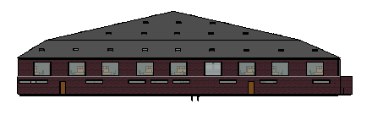
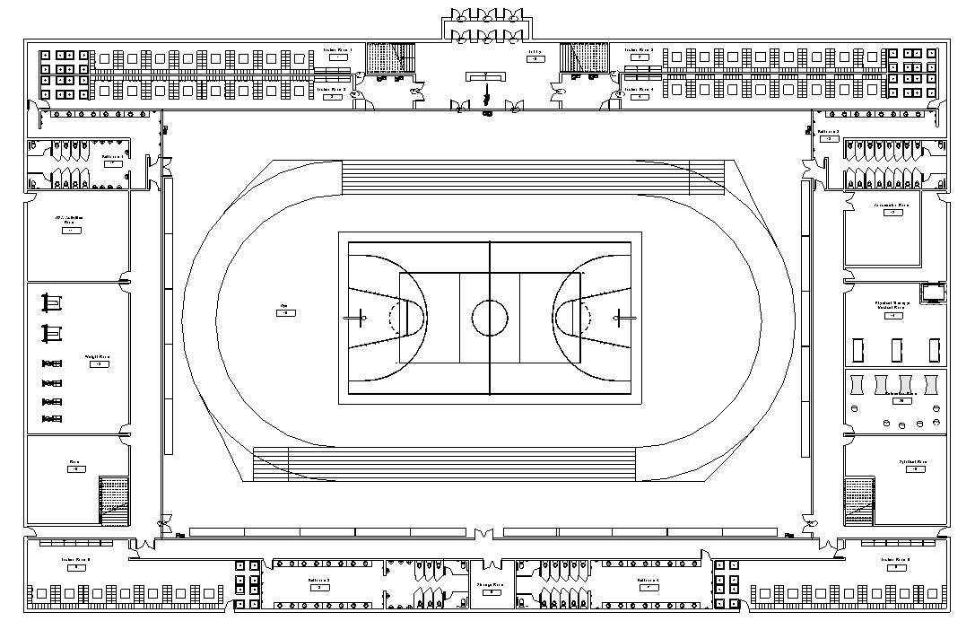
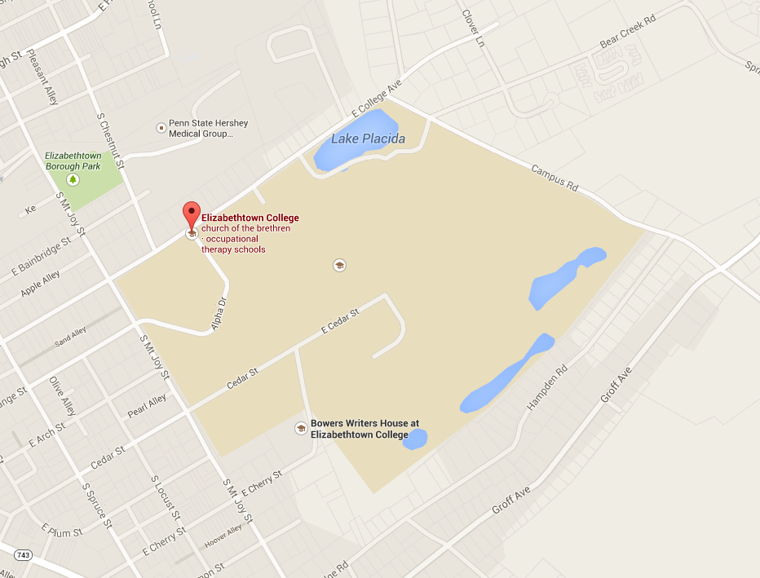
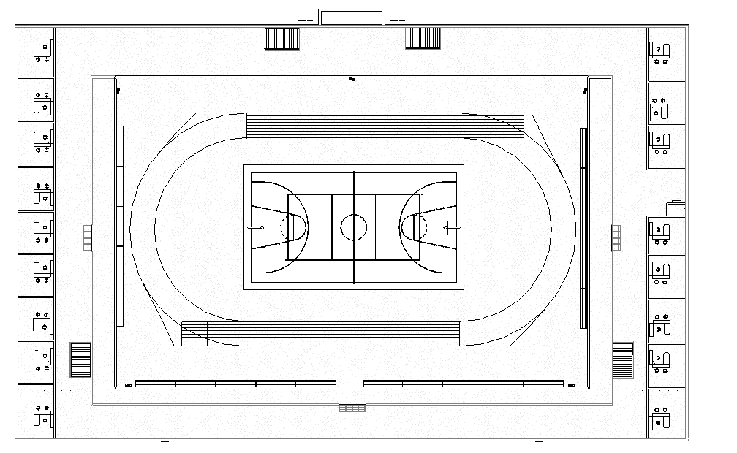
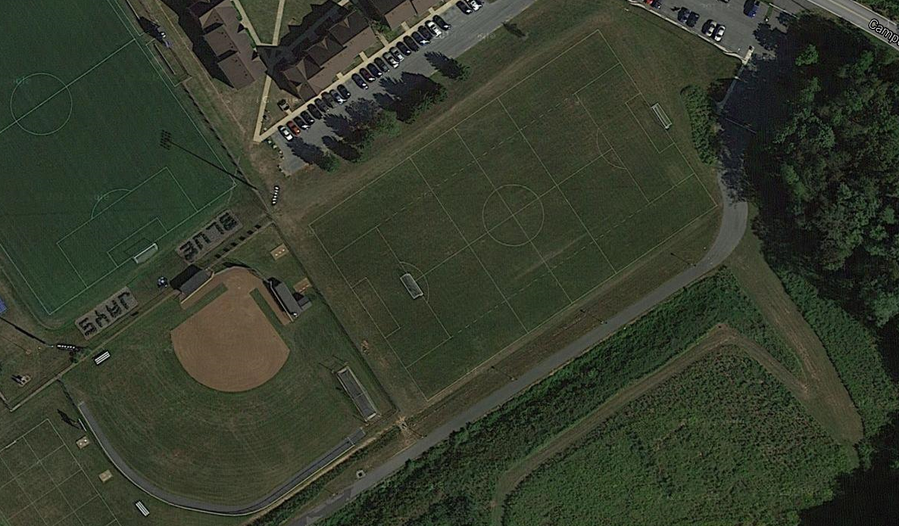
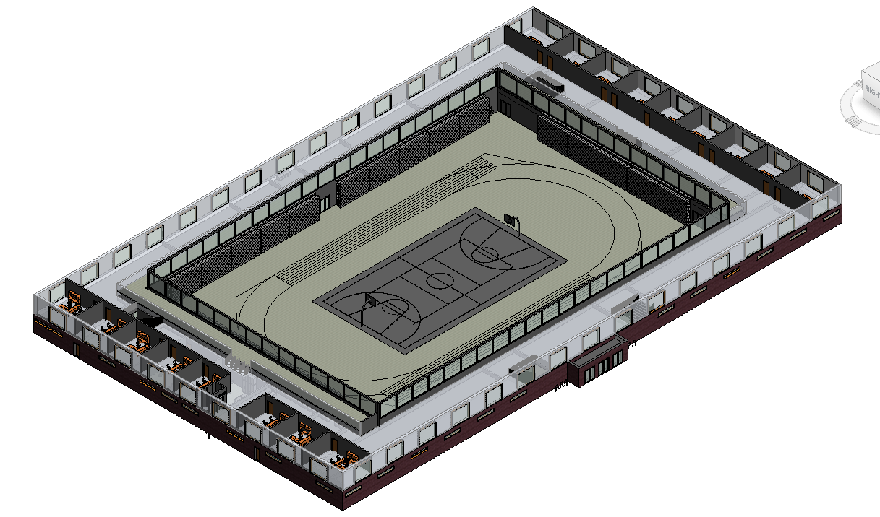
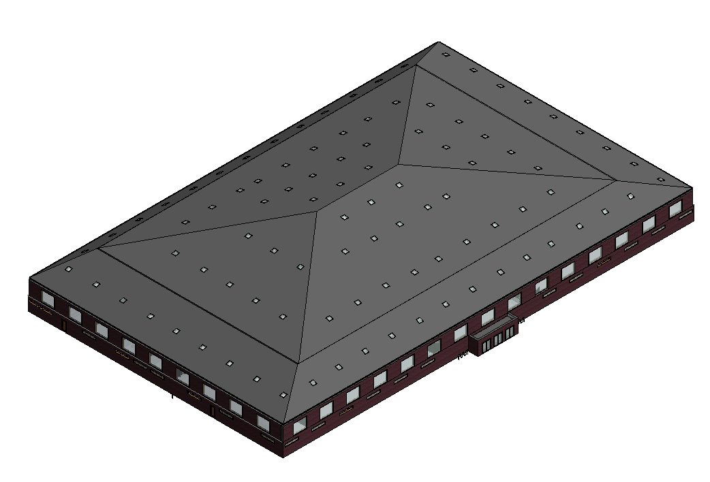
North Side
East Side
Site Selection
Potential LEED Credits
Location and Transportation
High Priority Site
Surrounding Density and Diverse Uses
Access to Quality Transit
Bicycle Facilities
Reduced Parking Footprint
Green Vehicles
Sustainable Sites
Construction Activity Pollution Prevention
Open Space
Rainwater Management
Heat Island Reduction
Light Pollution Reduction
Water Efficiency
Building-Level Water Metering
Outdoor Water Use Reduction
Indoor Water Use Reduction
Cooling Tower Water Use
Water Metering
Energy and Atmosphere
Optimize Energy Performance
Advanced Energy Metering
Demand Response
Renewable Energy Production
Green Power and Carbon Offsets
Materials and Resources
Storage and Collection of Recyclables
Construction and Demolition Waste Management Planning
Indoor Environmental Quality
Environmental Tobacco Smoke Control
Enhanced Indoor Air Quality Strategies
Indoor Air Quality Assessment
Thermal Comfort
Interior Lighting
Daylight
Elizabethtown, PA, 17022
40°09’02.9”N, 76°35’06.7”W
Overview
Old practice Soccer Field which rarely sees use
Located on the Northeastern side of campus
Site Features
Large Flat Landscape with relatively low use
Minimal Land Alterations Required
Accessible Location for current students, even more accessible for future housing plans
Parking Lot can be expanded so handicapped individuals can easily access the Wellness Center
Elevator for 2nd Floor access for injured/disabled
Green roof
Natural lighting/ light colors
First Floor
Second Floor
Proposal for a Wellness Center to be installed on Elizabethtown College Campus
Anthony Davala, Brian Brennan, Greyson McDonald
EGR 343: Green Architectural Engineering
Elizabethtown College, Elizabethtown, PA
Bleachers
Basketball Court
Track
Indoor Balcony
Skylights
Air-locked Doors
Bike Racks

